Slide 1
A View into OSHA in
2019 & 2020
November 6, 2019
Genesee Valley Chapter
American Society of Safety Professionals
Presenter:
Gordon DeLeys, Compliance Assistance Specialist

Slide 2
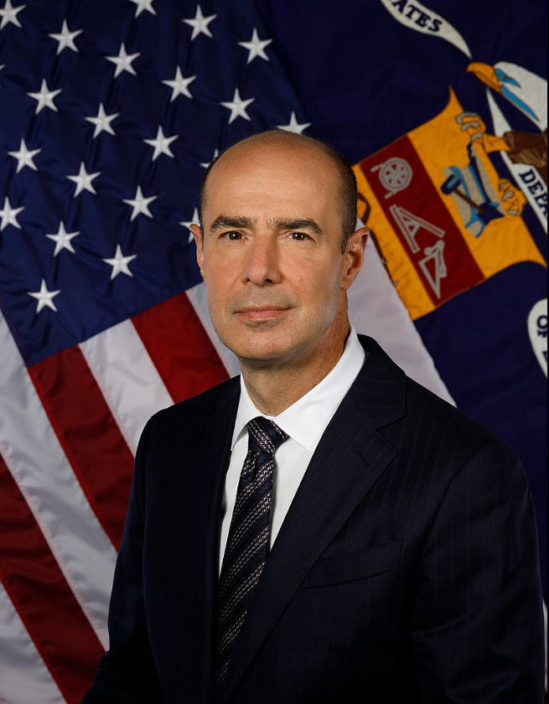
Current Administration
?
Eugene Scalia
Secretary of Labor
Assistant Secretary
of Labor for OSHA

Slide 3
A View into OSHA in 2019 & 2020
I. General Overview
II. Compliance Assistance
III. Enforcement
IV. OSHA Initiatives

Slide 4

I. General Overview
Occupational Safety and Health Act (OSH Act)
Signed
December 29, 1970
OSHA opened its doors
April 28, 1971
Notes:
OSH ACT
Worker safety in the United States is enforced by OSHA, which is nearing its 50th year of existence.
On December 29, 1970, President Richard Nixon signed the Occupational Safety and Health Act of 1970 (OSH Act) into law, establishing OSHA.
OSHA officially opened its doors on April 28, 1971.
Test Question:
22. OSHA must issue a citation within ___ of the occurrence of the violation: (TLO 5)
Three months
Six months
Twelve months
Five years
23. Citations are signed by the OSHA Area Director but they are not effective until they become a final order of: (TLO 5)
The Assistant Secretary for OSHA
The Occupational Safety and Health Review Commission
The Solicitor of Labor
The Secretary of Labor

Slide 5
OSH Act: Key Provisions
Duty of Employers to Provide Safe Workplaces
Occupational Safety and Health Standards
Inspections, Investigations, Recordkeeping
State Jurisdiction and State Plans
Federal Agency Safety and Health Programs
and Responsibilities
Notes:
OSH ACT: KEY PROVISIONS
How OSHA carries out its mission is laid out in the OSH Act.
The Act:
specifies the duty of employers to provide a safe and healthful workplace.
authorizes OSHA to develop and issue safety and health regulations.
authorizes OSHA to investigate workplaces.
outlines information regarding shared jurisdiction – for federal and state issues, as well as how OSHA works with other federal government agencies.
Test Question:
22. OSHA must issue a citation within ___ of the occurrence of the violation: (TLO 5)
Three months
Six months
Twelve months
Five years
23. Citations are signed by the OSHA Area Director but they are not effective until they become a final order of: (TLO 5)
The Assistant Secretary for OSHA
The Occupational Safety and Health Review Commission
The Solicitor of Labor
The Secretary of Labor

Slide 6
OSHA’s Continuing Mission
OSHA and its state partners, coupled with efforts of employers, safety & health professionals, unions and advocates, have helped dramatically reduce workplace injuries and illnesses.
Worker fatalities in America are down—
on average, from 38 workers a day in 1970
to 14 a day in 2017.
Worker injuries and illnesses are down—
from 10.9 incidents per 100 workers in 1972
to 2.8 per 100 in 2017.
Notes:
OSHA’S CONTINUING MISSION
Over the past several decades, OSHA and its partners have worked to dramatically reduce the number of workplace injuries and illnesses.
The number of worker fatalities have dropped from an average of 38 workers a day in 1970, to 14 a day in 2017.
Worker injuries have also declined significantly, from 10.9 incidents per 100 workers in 1972 to 2.8 per 100 in 2017.
These numbers show that we have made great progress, but we still have work to do to reach the ultimate goal of zero worker fatalities, injuries, or illnesses.

Slide 7
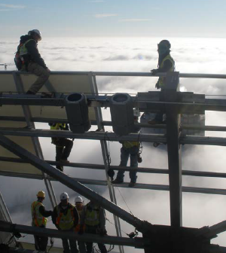
OSHA’s Balanced Approach
Enforcement
Compliance Assistance
Training
Notes:
OSHA’S BALANCED APPROACH
OSHA’s mission ha always been focuses on worker safety and health. Our common goal is that every worker goes home safe and healthy at the end of each day.
The agency is committed to maintaining a balanced approach to reaching this goal – through compliance assistance and enforcement.
The vast majority of employers strive to keep their workplaces safe, and comply with applicable laws. OSHA is working to provide compliance assistance, to give employers and employees the knowledge and tools they need to comply with their obligations and stay safe. Compliance with the law is mandatory. Employers that do not comply with the law will continue to see full enforcement.
Secretary of Labor Alexander Acosta has made it clear that protecting America’s workforce is a top priority. Under his leadership, the Department is committed to fully AND fairly enforcing the laws under its jurisdiction.
The expectation is for everyone in OSHA to carry out their duties professionally, respectfully, and by the book. The agency is not backing away from strong enforcement. Full and fair enforcement also helps level the playing field for the many employers who are responsible and comply with the law.
Employers who want help to do the right thing can take advantage of OSHA’s free and confidential Consultation Program. This is aimed at small employers who may not have the same resources as their larger counterparts. So, those who are responsible and want to comply with the law may do so.
OSHA also works directly with employers and industry associations though the alliance or partnership programs. Those with an exemplary safety and health program may participate in OSHA’s SHARP program or Voluntary Protection Programs. In all these efforts, successful programs include a component of worker involvement. After all, employees have a huge stake in having a safe workplace.
This is all part of a balanced approach that OSHA is taking to address workplace safety and health. Enforcement and compliance assistance are not mutually exclusive; in fact, they are complementary. The overriding principle is worker protection. All our efforts – rulemaking, enforcement, compliance assistance, cooperative programs – are not an end unto themselves; they are tools to accomplish our mission, and our mission is worker safety and health.

Slide 8
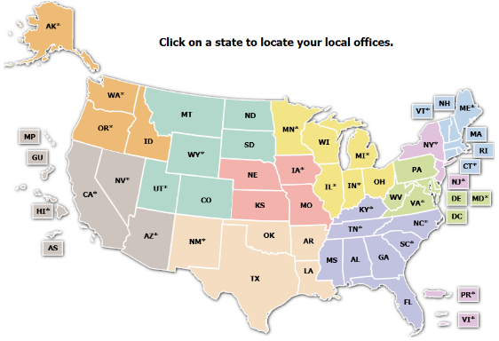
How OSHA is Organized
■ Region 1: Boston
■ Region 2: New York
■ Region 3: Philadelphia
■ Region 4: Atlanta
■ Region 5: Chicago
■ Region 6: Dallas
■ Region 7: Kansas City
■ Region 8: Denver
■ Region 9: San Francisco
■ Region 10: Seattle
Notes:
HOW OSHA IS ORGANIZED
OSHA is part of the Department of Labor.
The Agency has a central National Office, located in Washington, D.C.
OSHA also has 10 Regional Offices, which are located throughout the United States.
Each of these 10 regional geographic regions, which cover several states and contain multiple area offices.
Test Question:
22. OSHA must issue a citation within ___ of the occurrence of the violation: (TLO 5)
Three months
Six months
Twelve months
Five years
23. Citations are signed by the OSHA Area Director but they are not effective until they become a final order of: (TLO 5)
The Assistant Secretary for OSHA
The Occupational Safety and Health Review Commission
The Solicitor of Labor
The Secretary of Labor

Slide 9
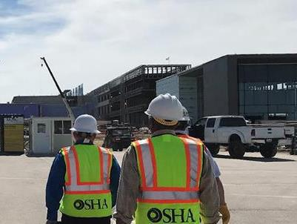
Regional and Area Office Functions
Inspections
Compliance Assistance
Outreach
Training
Penalty Collection
Abatement Assurance
Notes:
REGIONAL AND AREA OFFICE FUNCTIONS
Regional Offices include numerous Area Offices located within the Region, as well as specific programs (whistleblower protections, enforcement, cooperative and state programs, and administrative programs).
Regional and Area Office staff conduct a variety of activities. Their functions include:
investigating safety and health complaints,
performing inspections of worksites,
and conducting other activities, such as compliance assistance and training.
Test Question:
22. OSHA must issue a citation within ___ of the occurrence of the violation: (TLO 5)
Three months
Six months
Twelve months
Five years
23. Citations are signed by the OSHA Area Director but they are not effective until they become a final order of: (TLO 5)
The Assistant Secretary for OSHA
The Occupational Safety and Health Review Commission
The Solicitor of Labor
The Secretary of Labor

Slide 10
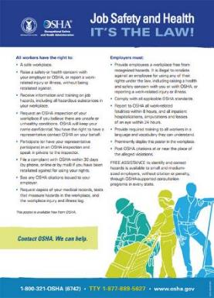
Employer Responsibilities
Provide a workplace free from serious recognized hazards.
Train workers in a language and vocabulary they can understand.
Comply with standards, rules and regulations issued under the OSH Act.
osha.gov/employers
Notes:
EMPLOYER RESPONSIBILITIES
The OSH Act lays out an employer’s responsibility to provide a workplace free from serious recognized hazards.
Employers must also ensure that workers are trained in a language and vocabulary they can understand. After all, training is ineffective if the worker was unable to fully understand the message.
All covered employers are required to display the OSHA poster, “Job Safety and Health: It's the Law,” in their workplaces. Employers must display the poster in a prominent place where workers can see it. It informs workers of their rights, and employers of their responsibilities, under the Occupational Safety and Health Act. This poster is available for free from OSHA. Employers do not need to replace previous versions of the poster.
Employers are also responsible for complying with standards, rules, and regulations set by OSHA under the OSH Act.
For more information on employer responsibilities, as well as helpful info on how to comply, please go to osha.gov/employers.

Slide 11

New YouTube Video

Slide 12

Recordkeeping
Many employers with more than
10 employees are required to keep
a record of serious work-related injuries and illnesses.
Certain low-risk industries are exempted
Minor injuries requiring first aid only do not need to be recorded.
Notes:
RECORDKEEPING
Many employers with more than 10 employees are required to keep a record of serious work-related injuries and illnesses. Certain low-risk industries are exempted
Minor injuries requiring first aid only do not need to be recorded.

Slide 13
Recordkeeping Forms
OSHA Form 300 – Log of Work-Related Injuries and Illnesses
OSHA Form 301 – Injury and Illness
Incident Report
OSHA Form 300A – Summary of Work-Related Injuries and Illnesses. This form must be posted from February to April every year.
Notes:
RECORDKEEPING FORMS
There are three forms that employers must complete. OSHA forms 300 and 301 are maintained on an ongoing basis. Recordable injuries and illnesses must be entered on these forms as they occur throughout the year.
The OSHA Form 300A is completed after the end of the year, summarizing the number of recordable cases that occurred.
Employers may use equivalent forms in place of these forms as long as the equivalent forms contain all of the same data elements and are as easy to read as the OSHA forms.

Slide 14

Recordkeeping Webpage
www.osha.gov/recordkeeping
Notes:
RECORDKEEPING WEBPAGE
OSHA’s Recordkeeping webpage includes links to reference documents that address the specific requirements of the recordkeeping rule and answer many common questions, and a link to the recordkeeping forms package. To learn the details of what you need to do to be in compliance with the recordkeeping rule, you may want to take some time to familiarize yourself with the Regulatory Text and FAQs posted on the website. It also includes a brief tutorial and presentations on complying with OSHA’s recordkeeping requirements.
If you have specific questions for which you cannot find direct guidance in these documents, you may want to try the Recordkeeping Q&A Search application.
Also, feel free to call your local OSHA office or submit your question using OSHA’s
e-correspondence web page—both found at osha.gov.

Slide 15

Reporting Fatalities and Severe Injuries
All employers are required to notify
OSHA when an employee dies on the job
or suffers a work-related hospitalization, amputation, or loss of an eye.
A fatality must be reported within 8 hours.
An in-patient hospitalization, amputation,
or eye loss must be reported within 24 hours.
Notes:
REPORTING FATALITIES AND SEVERE INJURIES
All employers are required to notify OSHA when an employee dies on the job or suffers a work-related hospitalization, amputation, or loss of an eye.
A fatality must be reported within 8 hours.
An in-patient hospitalization, amputation, or eye loss must be reported within 24 hours.

Slide 16
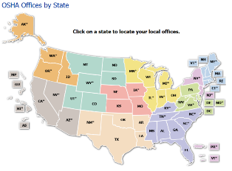
How to Report Fatalities and Severe Injuries
During business hours,
call the nearest OSHA office
Or call the OSHA 24-hour
hotline 1-800-321-6742 (OSHA)
Or report online at
osha.gov/report
Notes:
HOW TO REPORT FATALITIES AND SEVERE INJURIES
You have several options for how to report a fatality or severe injury: During business hours,
call the nearest OSHA office; you can call the OSHA 24-hour hotline 1-800-321-6742 (OSHA); or you can report online at osha.gov/report

Slide 17
Severe Injury Reporting
  Severe injury reporting
  is designed to:
  Better target the Agency’s compliance assistance and enforcement efforts in places where workers are at greatest risk
  Engage more high-hazard employers in identifying and eliminating serious hazards
Notes:
SEVERE INJURY REPORTING
Severe injury reporting is designed to better target the Agency’s compliance assistance and enforcement efforts in places where workers are at greatest risk; and it allows OSHA to engage more high-hazard employers in identifying and eliminating serious hazards.
Rapid Response Investigations (or RRIs) provide a way for OSHA to work with employers in a collaborative way to find and fix hazards.

Slide 18

Electronically Submitting
Injury and Illness Data
Covered employers must electronically submit
data from their OSHA Form 300A to OSHA using
OSHA’s Injury Tracking Application
Applies to establishments with 250 or more
employees that are currently required to keep
OSHA injury and illness records, and establishments
with 20-249 employees that are classified in certain industries with historically high rates of occupational injuries and illnesses
www.osha.gov/injuryreporting
Notes:
ELECTRONICALLY SUBMITTING INJURY AND ILLNESS DATA
Covered employers must electronically submit data from their OSHA Form 300A to OSHA using OSHA’s Injury Tracking Application.
This rule applies to—
establishments with 250 or more employees that are currently required to keep OSHA injury and illness records, and
establishments with 20-249 employees that are classified in certain industries with historically high rates of occupational injuries and illnesses

Slide 19
Worker Rights
Employees have the right to:
Report unsafe conditions and injuries
to management or OSHA
Assist an OSHA investigation
Request Training
Request PPE
Act of Congress
OSH ACT
of 1970
osha.gov/workers
Notes:
WORKER RIGHTS
Protecting workers means not only complying with regulations. Workers also have a legal right to raise safety and health concerns on the job without fear of retaliation.
Among other protections, workers have the right to—
report unsafe working conditions to their managers and to OSHA;
assist in an OSHA investigation; and
request Personal Protective Equipment (PPE) and training to make sure that they can do their jobs without exposure to hazards that can cause injury or illness.

Slide 20
Whistleblower Protections
Employers cannot retaliate against workers who exercise their rights.
Retaliation includes:
  Reduce pay or hours
  Being fired, laid off, or suspended
  Reassignment, discipline, or demotion
  Threats, harassment, and intimidation
  Blacklisted from hiring
Whistleblowers.gov
Notes:
WHISTLEBLOWER PROTECTIONS
It is against the law for employers to discipline or suspend their workers for reporting injuries or exercising other rights—and OSHA enforces this law.
Retaliation can include reducing pay or hours; firing, laying off or suspending workers; reassignment, discipline, or demotion; threats, harassment, or intimidation; and blacklisting from hiring.
It is well known that companies with effective safety and health programs actually find it helpful to encourage employees to report their concerns.
Think about it: Would you rather hear about a potential problem from your employee, or from a government inspector? Or, worse, not hear about it at all, and then suffer a mishap, an injury, or even a fatality?
[Insert your own local whistleblower protection story.]
When a worker brings a hazard or concern to a supervisor’s attention, the supervisor should welcome the worker’s comment, thank the worker for showing initiative, and, after the hazard has been managed, praise the worker in the presence of others to encourage more worker engagement in finding and fixing problems before workers get hurt.

Slide 21
Whistleblower Protections
OSHA enforces 23 federal whistleblower laws
  Employee safety
  Transportation services
  Environmental protection
  Financial industry
  Consumer product, motor vehicle, and food safety
  Health insurance
Newest statute: Taxpayer First Act
Whistleblowers.gov
Notes:
WHISTLEBLOWER PROTECTIONS
It is against the law for employers to discipline or suspend their workers for reporting injuries or exercising other rights—and OSHA enforces this law.
Retaliation can include reducing pay or hours; firing, laying off or suspending workers; reassignment, discipline, or demotion; threats, harassment, or intimidation; and blacklisting from hiring.
It is well known that companies with effective safety and health programs actually find it helpful to encourage employees to report their concerns.
Think about it: Would you rather hear about a potential problem from your employee, or from a government inspector? Or, worse, not hear about it at all, and then suffer a mishap, an injury, or even a fatality?
[Insert your own local whistleblower protection story.]
When a worker brings a hazard or concern to a supervisor’s attention, the supervisor should welcome the worker’s comment, thank the worker for showing initiative, and, after the hazard has been managed, praise the worker in the presence of others to encourage more worker engagement in finding and fixing problems before workers get hurt.

Slide 22
Safety Incentive Programs
Many employers use incentive programs to promote workplace safety and health. Drug testing is also used
to comply with workers’ comp carrier requirements
in post-incident situations.
OSHA memos address the structure of these policies:
  — Aug 2017 memo revises field guidance on incentive programs at VPP applicant/participant worksites
  — Oct 2018 memo clarifies OSHA's Position on incentive programs and drug testing under the Recordkeeping Standard
Notes:
WORKPLACE SAFETY INCENTIVE PROGRAMS
Many employers use incentive programs to promote workplace safety and health. Drug testing is also used to comply with workers’ comp carrier requirements in post-incident situations.
OSHA memos address the structure of these policies:
Aug 2017 memo revises field guidance on incentive programs at VPP applicant/participant worksites
Oct 2018 memo clarifies OSHA's Position on incentive programs and drug testing under the Recordkeeping Standard

Slide 23
Safety Incentive Programs:
Two Types and Results
Incentive programs can be an important tool
to promote workplace safety and health:
  — One type rewards workers for reporting near misses
  or hazards, and encourages involvement in a safety
  and health program..
  — Another type is rate-based and focuses on reducing
  the number of reported injuries and illnesses.
  Incentive programs are allowed, as long as the program and any employer actions as part of the program, do not discourage workers from reporting injuries or illnesses.
Programs cannot discourage workers from reporting!
Notes:
SAFETY INCENTIVE PROGRAMS: TWO TYPES AND RESULTS
Incentive programs can be an important tool to promote workplace safety and health.
One type of incentive program rewards workers for reporting near-misses or hazards, and encourages involvement in a safety and health program. Positive action taken under this type of program is always permissible.
Another type of incentive program is rate-based and focuses on reducing the number of reported injuries and illnesses. This type of program typically rewards workers with a prize or bonus at the end of an injury-free month or evaluates managers based on their work unit’s lack of injuries.
Rate-based incentive programs are also permissible, as long as they are not implemented in a manner that discourages reporting.
So: If an employer takes a negative action against a worker under a rate-based incentive program, such as withholding a prize or bonus because of a reported injury, then OSHA would not cite the employer, as long as the employer has implemented adequate precautions to ensure that workers feel free to report an injury or illness.

Slide 24
Safety Incentive Programs:
Creating Postitive Steps
A statement that workers are encouraged to report and
will not face retaliation may not be adequate to ensure
that workers actually feel free to report.
Employers can create a workplace culture that emphasizes safety, not just rates, by having:
  — an incentive program that rewards workers
  who identify unsafe conditions in the workplace
  — a training program for all workers to reinforce reporting rights and responsibilities, emphasizing the employer’s no-retaliation policy
  — a mechanism for accurately evaluating workers’
  willingness to report injuries and illnesses
Notes:
SAFETY INCENTIVE PROGRAMS: CREATING POSITIVE STEPS
A statement that workers are encouraged to report and will not face retaliation for reporting may not, by itself, be adequate to ensure that workers actually feel free to report, particularly when the consequence for reporting will be a lost opportunity to receive a substantial reward.
An employer could avoid any inadvertent deterrent effects of a rate-based incentive program by taking positive steps to create a workplace culture that emphasizes safety, not just rates. For example, any inadvertent deterrent effect of a rate-based incentive program on worker reporting would likely be counterbalanced if the employer also implements elements such as:
an incentive program that rewards workers for identifying unsafe conditions in the workplace;
a training program for all workers to reinforce reporting rights and responsibilities and emphasizes the employer’s non-retaliation policy;
a mechanism for accurately evaluating workers’ willingness to report injuries and illnesses.

Slide 25
Post-Incident Drug Testing
Drug tests cannot be retaliatory in nature
Workplace drug testing is allowed, as long as
the testing is not retaliatory in nature
Examples of permissible drug testing:
  — random testing
  — testing unrelated to reporting a work-related injury or illness
  — testing under a state workers’ compensation law
  — testing under other federal law
  — testing to evaluate the root cause of a workplace incident
Notes:
POST-INCIDENT DRUG TESTING
Most instances of workplace drug testing are allowed, as long as the testing is not retaliatory in nature.
Examples of permissible drug testing include:
random testing;
testing unrelated to the reporting of a work-related injury or illness;
testing under a state workers’ compensation law;
testing under other federal law, such as a U.S. Department of Transportation rule; and
testing to evaluate the root cause of a workplace incident that harmed or could have harmed workers. If the employer chooses to use drug testing to investigate the incident, the employer should test all workers whose conduct could have contributed to the incident, not just workers who reported injuries.

Slide 26


Training
TRAINING REQUIREMENTS
AND RESOURCES
Training must be provided to workers who face hazards on the job.
OSHA creates training materials, distributes training grants to nonprofit organizations, and provides training through authorized education centers.
OUTREACH TRAINING
(10- OR 30-HOUR CARDS)
OSHA TRAINING INSTITUTE
EDUCATION CENTERS
SUSAN HARWOOD
TRAINING GRANTS
Notes:
TRAINING
Training must be provided to workers who face hazards on the job. It’s the law, and it’s also good for every business. A highly trained workforce can minimize unnecessary costs and disruptions from an illness, injury, or fatality.
OSHA creates training materials, distributes training grants to nonprofit organizations, and provides training through authorized education centers.
Training must be provided to workers who face hazards on the job.

Slide 27

Training and Education
OSHA Outreach Training Program
(10- and 30-hour cards)
OSHA Training Institute
OSHA Training Institute
Education Centers
Susan Harwood Training Grants
www.osha.gov/dte
Notes:
TRAINING AND EDUCATION
Training must be provided to workers who face hazards on the job.
OSHA creates training materials, distributes training grants to nonprofit organizations, and provides training through authorized education centers.
The Outreach Training Program is a 10- or 30-hour course that OSHA-contracted Education Centers and other authorized trainers provide. (See the next slide for more detail.)
The OSHA Training Institute provides training and education in occupational safety and health for federal and state compliance officers, state consultants, other federal agency personnel, and the private sector.
The OSHA Training Institute’s Education Centers was initiated as an extension of the OSHA Training Institute. It is a national network of training sites offering OTI courses geared toward the private sector. The OTI Education Centers are the primary distribution channel for Outreach Trainer courses.
OSHA awards grants to nonprofit organizations on a competitive basis through its Susan Harwood Training Grant Program. Grants are awarded to provide training and education programs for employers and employees on the recognition, avoidance, and prevention of safety and health hazards in their workplaces. OSHA selects the safety and health topics and holds a national competition to award grants for Targeted Topic Training programs.

Slide 28

Prevent Workplace Violence
https://www.osha.gov/SLTC/workplaceviolence/
OSHA RECOMMENDS:
Policy Statement
Hazard/Threat/Security assessment
Workplace controls and prevention strategies
Training and education
Incident reporting and investigation
Periodic review with employee input
Notes:
WORKPLACE VIOLENCE
In most workplaces, the risk of workplace violence can be prevented or minimized if employers take appropriate precautions.
One of the best protections employers can offer their workers is to establish a zero-tolerance policy toward workplace violence. This policy should cover all workers, patients, clients, visitors, contractors, and anyone else who may come in contact with company personnel.
By assessing their worksites, employers can identify methods for reducing the likelihood of incidents occurring.
OSHA believes that a well-written and implemented workplace violence prevention program, combined with engineering controls, administrative controls and training can reduce the incidence of workplace violence in both the private sector and federal workplaces.
This can be a separate workplace violence prevention program or can be incorporated into an injury and illness prevention program, employee handbook, or manual of standard operating procedures.
It is critical to ensure that all workers know the policy and understand that all claims of workplace violence will be investigated and remedied promptly.
In addition, OSHA encourages employers to develop additional methods as necessary to protect employees in high risk industries.
OSHA has guidelines for preventing workplace violence in healthcare and social services settings.

Slide 29

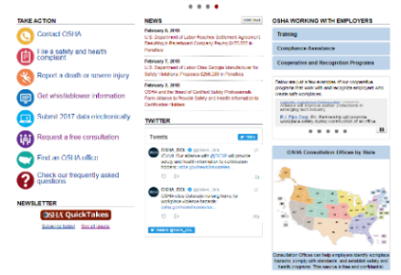
OSHA Web Resources
Compliance Assistance
Training
Cooperative Programs
Forms
Contact OSHA
osha.gov
Notes:
OSHA RESOURCES
OSHA has a wide variety of web resources to help employers and workers understand their rights and responsibilities. These include compliance assistance tools, training resources, information on cooperative resources, required forms, and ways to contact the agency with any questions or concerns.

Slide 30
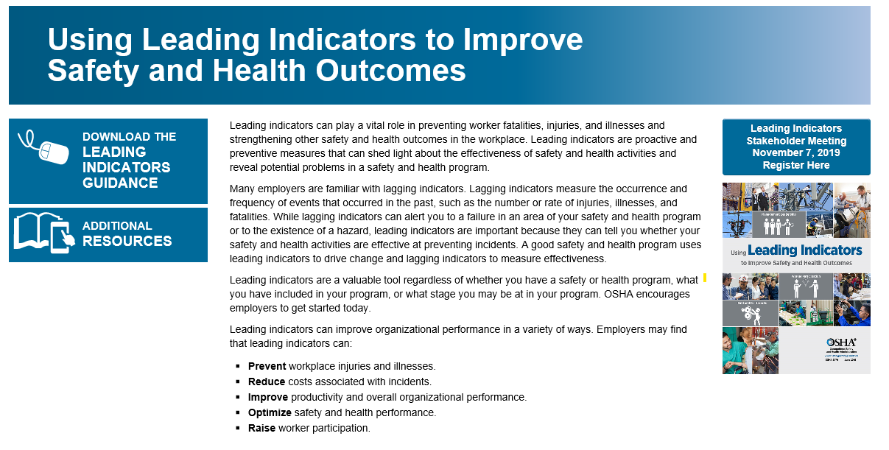
Leading Indicators Webpage www.osha.gov/leadingindicators
New!

Slide 31
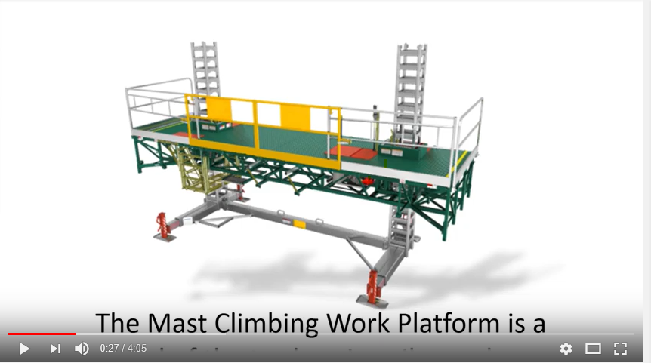
Mast Climbing Video
Product of an Alliance with the Scaffold & Access Industry Association
New!
https://www.youtube.com/watch?v=2d84d_0dEWA&feature=youtu.be

Slide 32

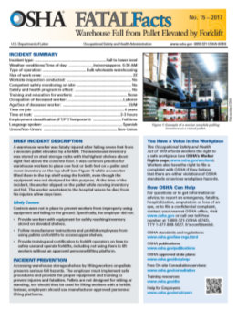








OSHA publications
for every workplace training need
osha.gov/publications
Notes:
OSHA PUBLICATIONS
Examining ways to improve the accessibility of information about available resources is a key project for OSHA. As new products are developed or updates of existing resources occur, a primary consideration is to carefully consider the varied audiences, and how they can best access and use our materials.
This approach applies to all the materials that the agency is creating for including in the web portal. Please let us know if there are materials you would like to see from us. Your input is welcome and appreciated; after all, these resources are created to help all of our stakeholders – particularly both employers and workers.

Slide 33
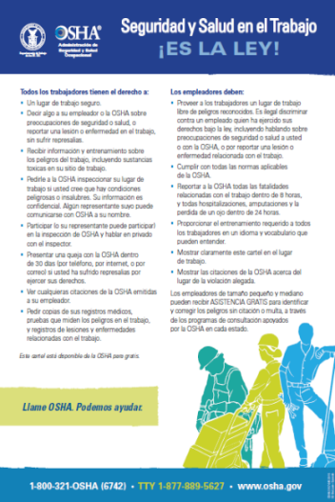

Spanish-Language Resources
OSHA Webpage
OSHA Poster
Publications
Videos
800 Number
Dictionaries
Notes:
SPANISH-LANGUAGE RESOURCES
OSHA has numerous Spanish-language resources online, and we are developing more all the time:
There is a Spanish version of the OSHA Webpage. On any page on the OSHA website, look to the top right and click on the “Spanish” link. The page is auto-translated.
The OSHA poster and many other publications are available in Spanish. On OSHA’s homepage, click “news/resources” at the top of the page and then, in the drop-down menu, click “publications.”
OSHA provides Spanish-speaking operators on its 800 number. The agency also offers a Spanish-language option for its e-correspondence system (to contact OSHA online with general safety and health questions), and Spanish-language information on how to file a complaint.
Also online: OSHA offers English-to-Spanish and Spanish-to-English dictionaries of OSHA terms, general industry terms, and construction terms.

Slide 34

OSHA QuickTakes
FREE OSHA e-newsletter delivered twice monthly
to more than 250,000 subscribers
Latest news about OSHA initiatives and products
to help employers and
workers find and prevent workplace hazards
Sign up at www.osha.gov
Notes:
OSHA QUICKTAKES
If you are not on the QuickTakes mailing list, you should consider it. This free newsletter provides the latest information about agency actions, events, new resources, training, and enforcement activities. This newsletter has more than 250,000 subscribers and the number continues to rise steadily. You can sign-up on the OSHA website.

Slide 35
Contact OSHA
Toll-free hotline: 1-800-321-OSHA (6742)
Submit email questions through OSHA’s website at www.osha.gov
Contact your local OSHA Area Office
Notes:
CONTACT OSHA
If you have any questions or concerns about workplace safety, OSHA wants to hear from you. We can discuss your concerns at events like this, but you can also reach out to us anytime in several ways.
Go to www.osha.gov and click on “Contact Us” link in “About OSHA” tab. There, you will find info on how to contact us through our 1-800 hotline, how to submit questions to us via our website, and how to locate contact info for your local OSHA area office.

Slide 36

II. Compliance Assistance
OSHA works with employers
to improve workplace safety
and health
Notes:
COMPLIANCE ASSISTANCE
Many employers understand their responsibilities and make every effort to comply with the law. OSHA is working to improve compliance assistance materials to make them more user friendly. This includes plain English or translating the documents into a language the worker speaks.

Slide 37

Prevention
saves lives
prevents injuries
saves money
Notes:
PREVENTION
Everything OSHA does is about preventing workplace injuries and illnesses Prevention saves lives, prevents injuries, and even helps businesses save money. That’s why prevention has to be everyone’s goal.

Slide 38
OSHA Working With Employers
2018 OSHA data
5,000 outreach activities by Regional & Area Offices
12,000 email requests for assistance answered
26,000 small businesses helped through Consultation
247,000 responses to OSHA 1-800 calls for help
250,000 subscribers to OSHA’s QuickTakes newsletter
500,000 views of OSHA’s videos on YouTube
1 million trained in OSHA’s Outreach Training Program
2.9 million workers removed from hazards
19 million people used OSHA’s website
Notes:
OSHA WORKING WITH EMPLOYERS
Each year OSHA provides assistance to nearly 250,000 individuals by phone (calling our 1-800 number) and another 12,000 email requests for help. OSHA’s regional and area offices conduct thousands of outreach activities. And, every year, OSHA's On-Site Consultation Program conducts more than 26,000 free on-site visits to small and medium-sized business worksites covering more than 1.3 million workers nationwide.
The Outreach Training Program trains more than 1 million workers. More than 19 million users visit OSHA’s webpage each year, and the agency’s videos receive half a million views on YouTube.
All-in-all OSHA’s compliance assistance efforts helped remove 2.9 million workers from hazards in 2018.

Slide 39
OSHA’s Cooperative Programs
On-Site Consultation Program
Safety and Health Achievement Recognition Program (SHARP)
Alliance Program
OSHA Strategic Partnership Program
Voluntary Protection Programs (VPP)
OSHA Challenge
Notes:
OSHA’S COOPERATIVE PROGRAMS
OSHA understands that working with stakeholders is the best way to achieve its mission.
OSHA’s Cooperative Programs are excellent ways for employers, employees, and associations to work with OSHA on meaningful safety and health initiatives.
These programs include the:
On-Site Consultation Program;
Safety and Health Achievement Recognition Program (SHARP);
Alliance Program;
Strategic Partnership Program;
Voluntary Protection Programs (VPP); and
OSHA Challenge.

Slide 40

On-Site Consultation Program
No cost to employers
Separate from enforcement
and confidential
Identifies workplace hazards
Advice on compliance with OSHA standards
Helps employers establish safety and health programs
26,000 visits annually to small employers
Notes:
ON-SITE CONSULTATION PROGRAM
OSHA’s On-Site Consultation Program offers no-cost advice to small and medium-sized businesses. Priority is given to high-hazard worksites.
On-Site Consultation services are separate from enforcement. This mean that they do not result in penalties or citations.
Through this program, OSHA works with the employer to find and fix hazards. The goal is for the business to meet its legal requirements, and to establish or improve its safety and health program.
The On-Site Consultation Program does not just save worker lives; it can also help businesses save money. When businesses lower their injury and illness rates, they save money on workers’ compensation insurance premiums and lost time from worker injuries.
Each year, OSHA's On-Site Consultation Program conducts more than 26,000 free on-site visits.
Employers who have a consultation visit and meet other requirements can be recognized under the Safety and Health Achievement Recognition Program (SHARP).

Slide 41

Safety and Health Achievement
Recognition Program (SHARP)
Recognizes businesses as models
for worksite safety and health
Deferrals from OSHA's programmed
enforcement inspections while
SHARP certification is valid
Companies must meet strict eligibility requirements
to be recognized for SHARP
1,322 SHARP sites
Notes:
SAFETY AND HEALTH RECOGNITION PROGRAM (SHARP)
SHARP recognizes small business employers who have used consultation services, and have a great safety and health program.
OSHA’s acceptance of a worksite into SHARP recognizes businesses as a model for worksite safety and health.
Upon receiving SHARP recognition, worksites are exempted from programmed enforcement inspections while its SHARP certification is valid.
The initial deferral period may be up to 2 years, with subsequent renewals for 3 year periods.
To participate in SHARP, businesses must meet certain requirements. Some of those requirements include:
having no more than 250 employees onsite, and fewer than 500 company-wide;
requesting an On-Site Consultation visit, and correcting all hazards identified during the visit;
involving workers in safety and health efforts; and
having a safety and health program that meets minimum requirements.
At the end of FY 2018, there were 1,322 SHARP participants across the U.S.

Slide 42

OSHA Challenge
Avenue to develop or improve
safety and health programs
Volunteer administrators provide mentoring, training and progress tracking
Currently 103 participants in OSHA Challenge
81 employers have graduated from OSHA Challenge; 31 of these employers achieved VPP recognition
Notes:
OSHA CHALLENGE
OSHA Challenge provides businesses with the opportunity to get help in improving their safety and health programs.
Challenge Administrators, who are experienced in safety and health, work directly with businesses. Administrators provide participants with mentoring, training, and progress tracking.
This program guides participants through the entire process of implementing an effective safety and health program.
As of January, there were 103 active participants in OSHA Challenge.
Since OSHA Challenge began in 2004, 81 employers have “graduated” from the program. 31 of those graduates went on to become Voluntary Protection Program (VPP) participants.

Slide 43

Voluntary Protection Programs
Participants:
Exceed OSHA standards
Develop and implement
effective safety and health programs
Mentor other employers and workers
1,386 federal VPP sites currently
Notes:
VOLUNTARY PROTECTION PROGRAMS
VPP recognizes employers and workers who have implemented effective safety and health programs. These participants are committed to effective worker protection beyond the requirements of OSHA standards.
VPP participants also maintain injury and illness rates below the national averages for their respective industries. Participants also mentor other employers and workers. VPP participants are seen as being “the best of the best”, and set the standard for other businesses to follow.
In VPP, management, workers, and OSHA work together to prevent fatalities, injuries, and illnesses. They do this through a system focused on: hazard prevention and control; worksite analysis; training; and management commitment and worker involvement.
Worker involvement is very important. Workers are usually in the best position to notice hazards when they first appear. Having workers heavily involved in the safety and health program helps businesses address hazards quickly, and hopefully before anyone gets hurt.
As of 2018, there were 1,386 VPP Sites working with federal OSHA.

Slide 44
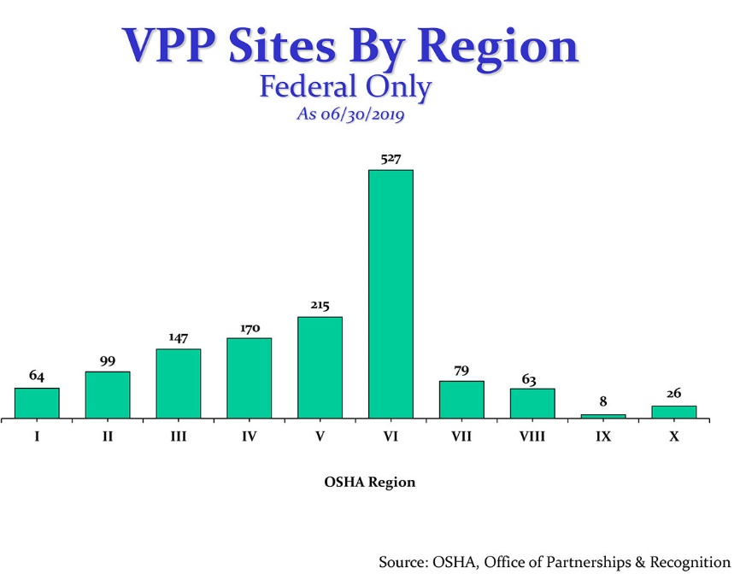

Slide 45
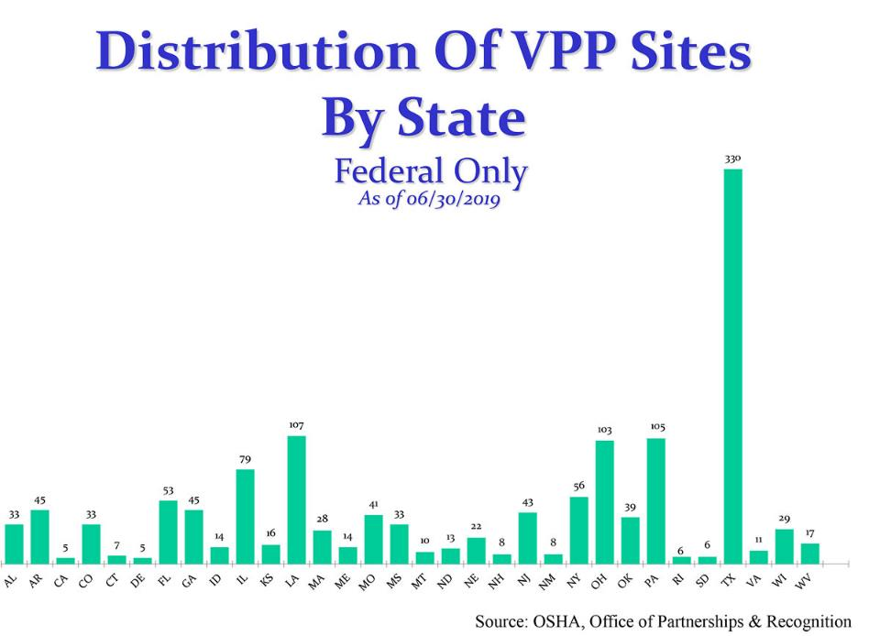

Slide 46
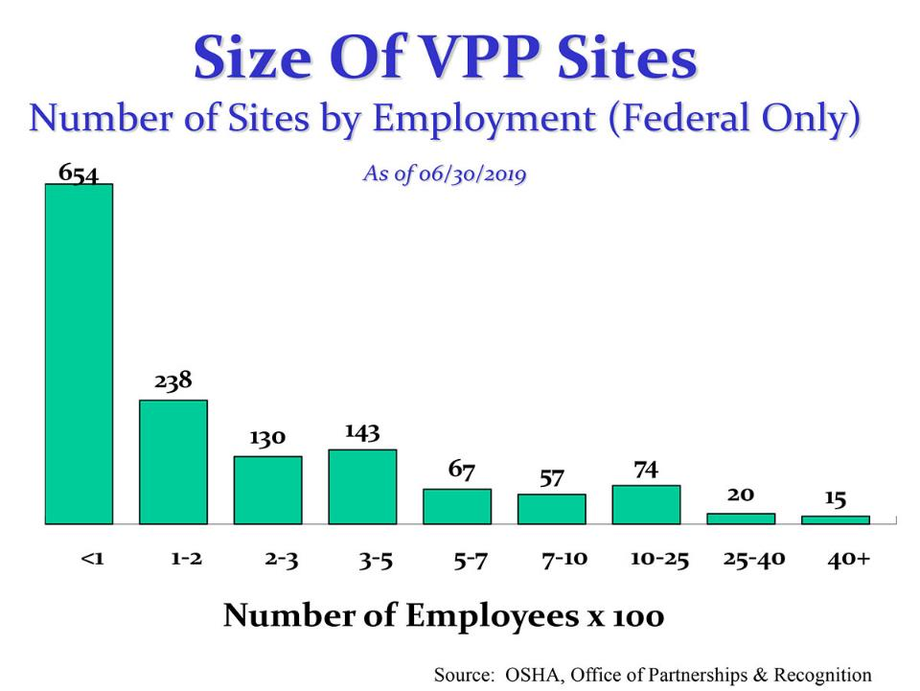

Slide 47
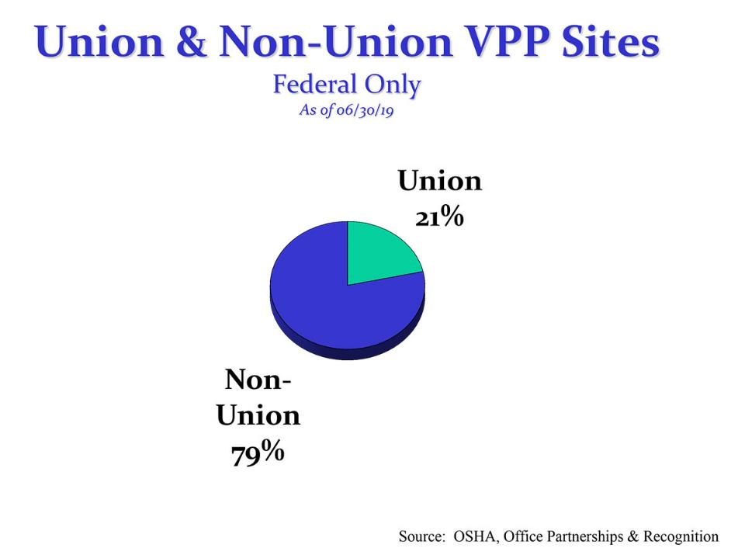

Slide 48
VPP Sites in WNY
American Packaging Corporation, Rochester, NY
Covanta Niagara 1, LLC, Niagara Falls, NY
Georgia Pacific Corrugated III, LLC, Batavia, NY
Goodyear Tire & Rubber Co., Niagara Falls, NY
Honeywell UOP, Tonawanda, NY
Mollenberg-Betz, Inc., Buffalo, NY
Occidental Chemical Company, Niagara Falls, NY
Olin Corporation, Niagara Falls, NY
Ortho-Clinical Diagnostics Inc., Rochester, NY

Slide 49

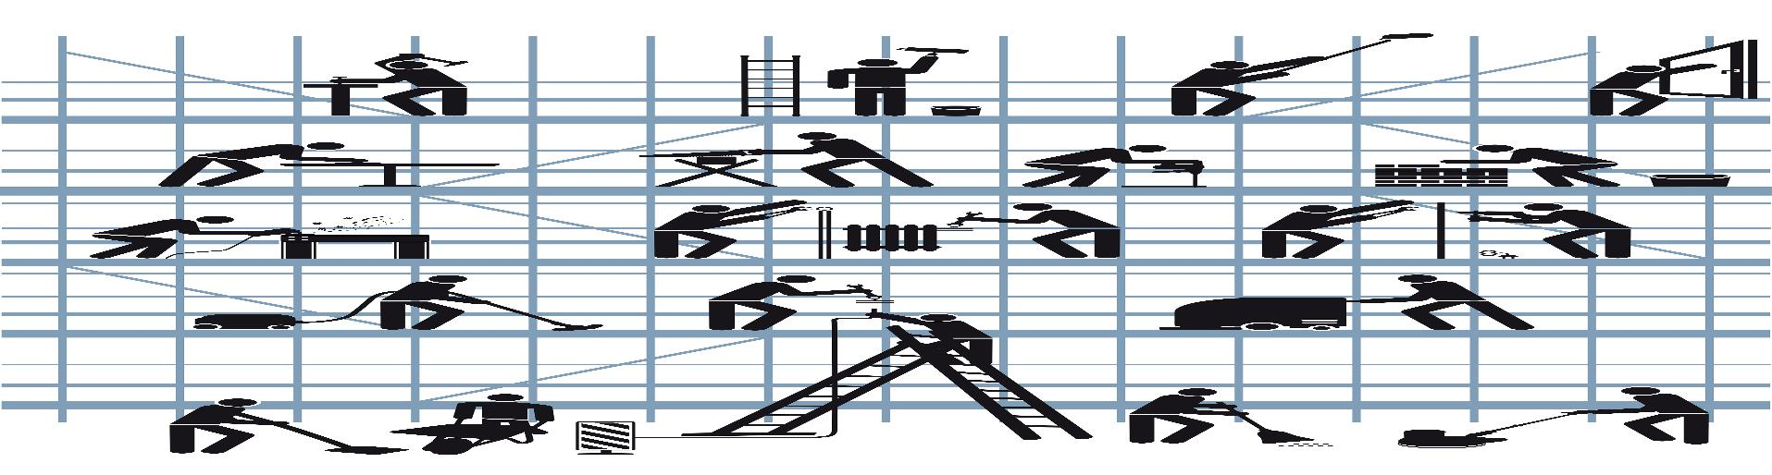
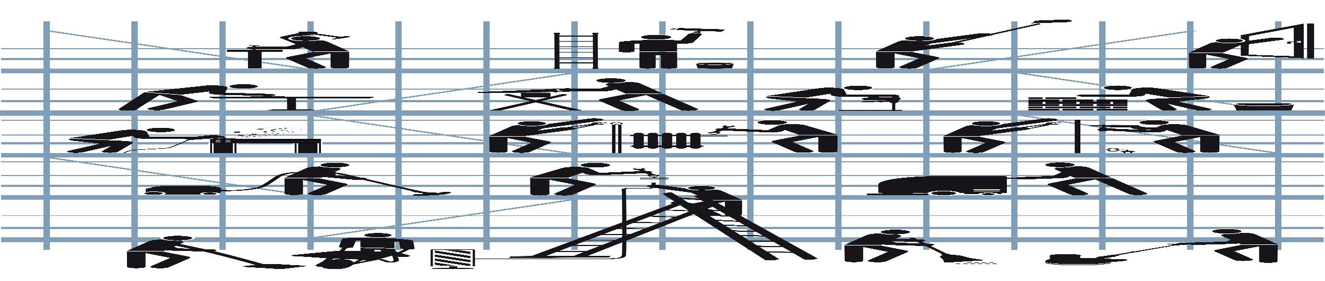
VPP National Impact
Nearly 800,000 workers covered
Injury and illness rates are 50%
or lower than industry averages
Notes:
VPP NATIONAL IMPACT
Nearly 800,000 employees and contractors are currently covered under VPP.
The injury and illness data collected from VPP sites illustrate that, on average, injury and illness rates for VPP sites are at least 50% or lower than the national averages for their industries.
This means that workers on VPP sites have a much lower chance of getting hurt on the job than workers at non-VPP sites.
It also means that, on average, VPP sites are doing a good job of meeting their obligations to stay in the program.

Slide 50

OSHA Strategic Partnership Program
OSHA and stakeholders
collaborate on ways to
improve conditions for workers
Strategic Partnerships are made at the national, regional, and area office levels
Successfully reduce worker fatalities, injuries, and illnesses
Notes:
STRATEGIC PARTNERSHIP PROGRAM
Strategic Partnerships allow OSHA to partner with employers, workers, and other interested stakeholders.
This program is focused on improving safety and health in major corporations/government agencies, at large construction projects, and for entire industries. Partnerships are developed at the national, regional, and local levels.
Participants establish specific goals, strategies, and performance measures to improve worker safety and health.
As of January, there were 58 active Strategic Partnerships with 943 employers participating. These partnerships cover over 200,000 employees.
Since the program began in 1998, more than 2 million employees have been protected from safety and health hazards through a partnership.

Slide 51

Alliance Program
Positive relationships
with workers and employers:
Build trust
Encourage information sharing
Promote education
Local Alliance with Lehigh Construction Group, Inc.
Notes:
ALLIANCE PROGRAM
The Alliance Program was launched in 2002 to reach workers and employers that were not being reached by OSHA’s other cooperative programs.
Through the Alliance Program, OSHA works with groups committed to worker safety and health to prevent workplace fatalities, injuries, and illnesses.
OSHA and the groups work together to share information with workers and employers, educate workers and employers about their rights and responsibilities, and develop compliance assistance tools and resources.
Alliance agreements are not worksite-based – they generally focus on entire industries or hazards within the industries.

Slide 52
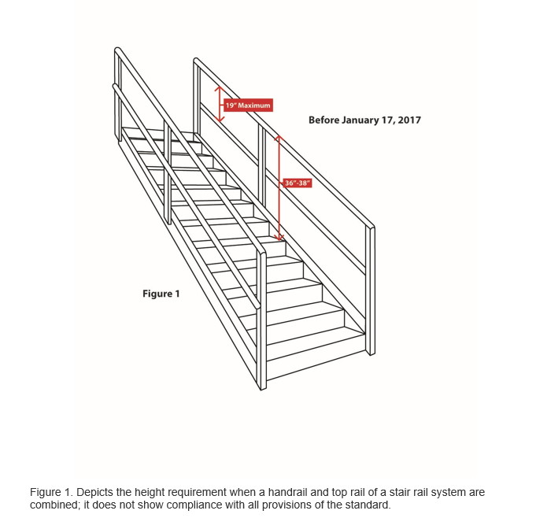
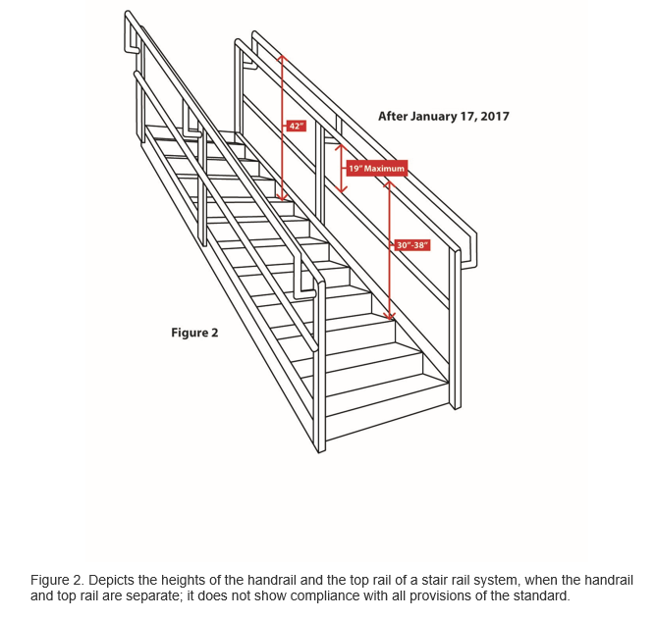
Clarification Heights of Handrail and Stair Rail Systems under 1910.29(f)(1)(ii)(B) and 1910.29(f)(1)(iii)(A)

Slide 53
“New” Respirator Fit-test Protocols in Appendix A of the Respiratory Protection Standard
Two new protocols were approved on September 26, 2019
  Modified ambient aerosol condensation nuclei counter (CNC) QNFT protocol for full and half-mask elastomeric respirators
  Modified ambient aerosol CNC QNFT protocol for filtering facepiece respirators
  Both are abbreviated variations of the Portacount® protocol
    Differ by the exercise sets, exercise duration and sampling sequence

Slide 54
III. OSHA Enforcement
OSHA conducts inspections based on:
Imminent danger situations
Worker fatalities, hospitalizations, amputations, or loss of an eye
Referrals
Targeted inspections
Follow-up inspections
Notes:
Enforcement plays an important part in OSHA’s efforts to reduce workplace injuries, illnesses, and fatalities.
When OSHA finds employers who fail to uphold their safety and health responsibilities, the agency takes strong, decisive actions.
Inspections are initiated without advance notice, conducted using on-site or telephone and facsimile investigations, and performed by highly trained compliance officers.
OSHA schedules inspections based on the following priorities:
Imminent danger situations
Catastrophes – fatalities, hospitalizations, amputations, or the loss of an eye
Worker complaints and referrals
Targeted inspections – particular hazards, high injury rates
Follow-up inspections

Slide 55
Types of Inspections
Unprogrammed inspections
Programmed inspections
Notes:
TYPES OF INSPECTONS
OSHA conducts enforcement activities through two different inspection types – unprogrammed and programmed.
Programmed inspections specifically target the most dangerous workplaces and the most recalcitrant employers.
Unprogrammed inspections are initiated for several reasons, including worker complaints, referrals, employer reports and follow-up inspections.

Slide 56
Unprogrammed Activity
Imminent Danger
Fatality/Catastrophe
Complaints/Referrals
!
Notes:
UNPROGRAMMED ACTIVITY
Approximately 60% of OSHA inspections are for unprogrammed activity.
Unprogrammed activity has higher priority than programmed activity.
Unprogrammed activity includes imminent danger situations, fatalities and catastrophes, and complaints and referrals.
The highest priority goes to activity involving an imminent danger situation. This is where there is a high likelihood for a fatality or serious injury if the hazard is not addressed.
The next priority situation is where a worker has died or been hospitalized. OSHA would initiate an inspection to determine how the incident occurred, and to address the hazard before anyone else is killed or injured.
Inspections would also be conducted for formal employee complaints, or referrals, that involve serious hazards.
If a complaint involves a situation that is considered “other-than-serious”, OSHA would allow the employer to conduct a self-investigation and respond back with the results. The same process is used if the complaint comes from a former employee.

Slide 57

Programmed Activity
Emphasis Programs
  Silica NEP
  Amputation NEP
    Targets 80 industries having machinery that have the
    potential to cause amputations
    MOU with NYS Workers Comp
  Combustible Dust NEP
  Hexavalent Chromium NEP
  Lead NEP
Notes:
PROGRAMMED ACTIVITY
Programmed inspections result from special emphasis programs and site-specific targeting.
Emphasis Programs focus on outreach and inspection efforts on specific hazards or industries. They are conducted at the National, Regional, or Local level depending on where the hazards are most prevalent.
National Emphasis Programs provide for programmed inspections of establishments in industries with potentially high injury or illness rates.
Local and Regional Emphasis Programs are enforcement strategies intended to address hazards or industries that pose a particular risk to workers in that office's jurisdiction.
The Site-Specific Targeting Program is OSHA’s main inspection plan for non-construction workplaces that have 20 or more employees.
The Site-Specific Targeting Program directs enforcement resources to those workplaces with the highest rates of injuries and illnesses. OSHA uses illness and injury information submitted by employers to determine when and where to use this program.

Slide 58
Programmed Activity
Emphasis Programs
  Primary Metal Industries NEP
  Process Safety Management (PSM) NEP
  Trenching and Excavation NEP
  Ship Breaking NEP
  Noise REP
    Targets 35 industries with hearing loss rates of ≥15.0
  Fall Hazards in Construction REP
Notes:
PROGRAMMED ACTIVITY
Programmed inspections result from special emphasis programs and site-specific targeting.
Emphasis Programs focus on outreach and inspection efforts on specific hazards or industries. They are conducted at the National, Regional, or Local level depending on where the hazards are most prevalent.
National Emphasis Programs provide for programmed inspections of establishments in industries with potentially high injury or illness rates.
Local and Regional Emphasis Programs are enforcement strategies intended to address hazards or industries that pose a particular risk to workers in that office's jurisdiction.
The Site-Specific Targeting Program is OSHA’s main inspection plan for non-construction workplaces that have 20 or more employees.
The Site-Specific Targeting Program directs enforcement resources to those workplaces with the highest rates of injuries and illnesses. OSHA uses illness and injury information submitted by employers to determine when and where to use this program.

Slide 59
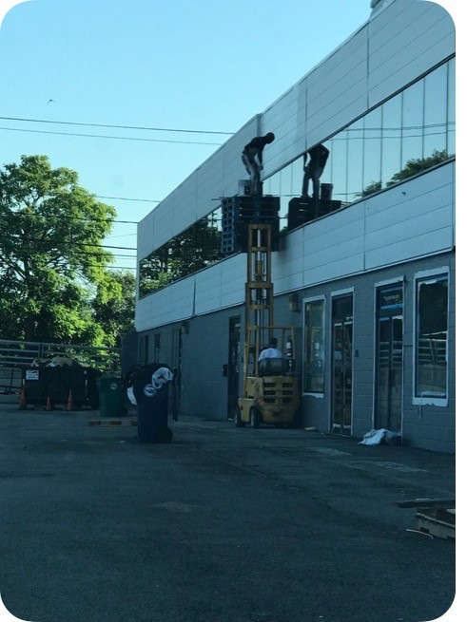

Slide 60
Programmed Activity
Emphasis Programs
  Health High Hazard REP
  Warehousing and Refuse Handlers and Haulers REP
  Construction Worksites-Local Targeting REP
  Federal Agencies REP
  Gut Rehabilitation and Demolition REP
  Dairy Farm Operations LEP
  Heavy Highway and Bridge Construction and
  Maintenance LEP
Notes:
PROGRAMMED ACTIVITY
Programmed inspections result from special emphasis programs and site-specific targeting.
Emphasis Programs focus on outreach and inspection efforts on specific hazards or industries. They are conducted at the National, Regional, or Local level depending on where the hazards are most prevalent.
National Emphasis Programs provide for programmed inspections of establishments in industries with potentially high injury or illness rates.
Local and Regional Emphasis Programs are enforcement strategies intended to address hazards or industries that pose a particular risk to workers in that office's jurisdiction.
The Site-Specific Targeting Program is OSHA’s main inspection plan for non-construction workplaces that have 20 or more employees.
The Site-Specific Targeting Program directs enforcement resources to those workplaces with the highest rates of injuries and illnesses. OSHA uses illness and injury information submitted by employers to determine when and where to use this program.

Slide 61
Inspection Process
Opening Conference
Walkaround
Closing Conference
Contest/Resolution
Notes:
INSPECTION PROCESS
OSHA’s on-site inspection begins with the compliance officer showing his or her credentials. This leads into an opening conference, which is a meeting between the OSHA inspector and the employer representative.
The compliance officer will explain why OSHA selected the workplace for inspection, and explain the inspection process. They will describe the scope of the inspection, walkaround procedures, employee representation, and the process for employee interviews.
Following the opening conference, the compliance officer and the representatives will walk through portions of the workplace covered by the inspection. This is called the walkaround. During the walkaround, they will look for hazards that could lead to worker injury or illness.
After the walkaround, the compliance officer will hold a closing conference with the employer and the employee representative to discuss the findings.
When an inspector finds violations of OSHA standards or serious hazards, OSHA may issue citations and fines.
A citation includes methods an employer may use to fix a problem and the date by which they must do so. Employers have the right to contest any part of the citation, including whether a violation actually exists. Workers only have the right to challenge the deadline by which a problem must be resolved.
Appeals of citations are heard by the independent Occupational Safety and Health Review Commission (OSHRC).

Slide 62
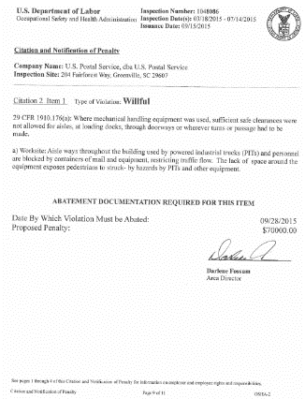
Violation Elements
Applicable Standard
Existence of Hazard
Exposure to Hazard
Employer Knowledge
Notes:
To prove that a violation has occurred, OSHA has to prove four elements:
--That an applicable standard exists
--That a hazard existed
--That an employee was exposed to the hazard, and
--That the employer knew, or should have known of the violation.
Citations are reviewed and issued at the Area Office Level. However, some types of citations or inspection scenarios might require a higher level of review.
OSHA has six months to issue a citation.

Slide 63
Violation Classification
Other-than-Serious
Serious
Repeated
Willful
Failure to Abate
Notes:
VIOLATION CLASSIFICATION
There are five main types of violations issued by OSHA. They are serious, other-than-serious, repeated, willful, and failure to abate. Let’s walk through each of those.
Other-than-Serious Violations
Other-than-Serious violations are issued when the most likely result from a hazardous condition would probably not be death or serious physical harm.
These violations would, however, have a direct and immediate impact on the safety and health of employees.
Serious Violations
Serious violations are issued if it is probable that death or serious physical harm could result.
A determination must also be made that it is a recognized hazard. This is often determined on the basis of employer or industry recognition of the hazard.
Repeated Violations
Repeated violations are issued if an employer has been cited previously for the same or a substantially similar hazard.
This only applies if the previous citation has become a final order. A citation may become a final order when an employer does not contest the citation, or by a court decision or settlement.
The previous citation must have become a final order before the occurrence or observation of the second violation.
Willful Violations
Willful violations are issued when an employer has demonstrated either intentional disregard for the law, or plain indifference to worker safety and health.
Failure to Abate Violations
Failure to abate violations are issued when a previously cited violation has not been corrected.
However, if the violation was corrected, but later reoccurs, the subsequent violation is not considered a failure to abate. It would be deemed a repeated violation.
Test Question:
22. OSHA must issue a citation within ___ of the occurrence of the violation: (TLO 5)
Three months
Six months
Twelve months
Five years
23. Citations are signed by the OSHA Area Director but they are not effective until they become a final order of: (TLO 5)
The Assistant Secretary for OSHA
The Occupational Safety and Health Review Commission
The Solicitor of Labor
The Secretary of Labor

Slide 64
Penalties
Type of Violation | Penalty
Serious Other-Than-Serious Posting Requirements | $13,260 per violation
Failure to Abate | $13,260 per day beyond the abatement date
Willful or Repeated | $132,598 per violation
Notes:
PENALTIES
The OSH Act authorizes OSHA to issue penalties for health and safety hazards. The OSH Act also sets forth the types and amounts of potential penalties.
OSHA assesses and collects penalties when violations are found. OSHA does not keep the money collected from penalties. This money goes into the U.S. Treasury’s general fund.
Prior to 2015, OSHA’s penalties had not been adjusted since 1990. In 2015, the U.S. Congress acted to require agencies to do a one-time adjustment to penalty amounts, followed by annual adjustments for inflation.
Test Question:
22. OSHA must issue a citation within ___ of the occurrence of the violation: (TLO 5)
Three months
Six months
Twelve months
Five years
23. Citations are signed by the OSHA Area Director but they are not effective until they become a final order of: (TLO 5)
The Assistant Secretary for OSHA
The Occupational Safety and Health Review Commission
The Solicitor of Labor
The Secretary of Labor

Slide 65
Penalty Adjustment Factors
History
Good Faith
Size
Notes:
PENALTY ADJUSTMENT FACTORS
When setting a penalty, OSHA begins with the maximum penalty, then makes adjustments based on a variety of factors.
The Agency generally reduces penalties for small employers, those acting in good faith, and employers with no recent citations.
A 10% reduction may be given for employers who were inspected within the last five years with no serious violations. However, the penalty can be increased by 10% for companies that have been issued serious citations within the past five years.
A reduction of either 15% or 25% can be given to companies who demonstrate a good faith effort to address safety and health issues in the workplace.
And a reduction can be given for the company’s size (number of employees), up to 70% for companies with fewer than 11 employees.
Test Question:
22. OSHA must issue a citation within ___ of the occurrence of the violation: (TLO 5)
Three months
Six months
Twelve months
Five years
23. Citations are signed by the OSHA Area Director but they are not effective until they become a final order of: (TLO 5)
The Assistant Secretary for OSHA
The Occupational Safety and Health Review Commission
The Solicitor of Labor
The Secretary of Labor

Slide 66
Criminal Referrals
Criminal sanctions are
outlined in the OSH Act
To obtain a conviction,
a prosecutor must establish certain
conditions beyond a reasonable doubt
Notes:
CRIMINAL EFERRALS
The OSH Act also provides for a criminal penalty of up to six months in prison and a $10,000 fine if an employer’s willful violation of an OSHA standard causes the death of an employee.
When employers willfully neglect their responsibilities, OSHA responds with strong, decisive actions – including criminal referrals to the U.S. Department of Justice.
To obtain a conviction, there must be proof beyond a reasonable doubt that:
--the employer is engaged in a business affecting commerce;
--the employer violated a regulatory standard promulgated under the OSH Act;
--that the violation was willfully committed; and
--that the violation was a direct cause of an employee’s death.
In December 2015, the U.S. Department of Labor and the U.S. Department of Justice entered into a Memorandum of Understanding (MOU) to increase the frequency and effectiveness of criminal prosecutions.
The agreement establishes a process and framework for notification, consultation, and coordination between the two Departments.
As a result, the Department of Justice has directed U.S. attorneys to more aggressively consider criminal referrals from the Department of Labor.
U.S. attorneys also consider prosecution for false statements, retaliating against a witness, destruction or falsification of records, and other actions. Sanctions for these violations include criminal sentences of up to 20 years per charge, and penalties of $250,000 against individuals and $500,000 against corporations.
Test Question:
22. OSHA must issue a citation within ___ of the occurrence of the violation: (TLO 5)
Three months
Six months
Twelve months
Five years
23. Citations are signed by the OSHA Area Director but they are not effective until they become a final order of: (TLO 5)
The Assistant Secretary for OSHA
The Occupational Safety and Health Review Commission
The Solicitor of Labor
The Secretary of Labor

Slide 67
FY ‘19 Enforcement Statistics
Buffalo Area Office
(10/1/2018 to 09/30/2019)
484 Inspections:
  399 safety (82%)
  85 health (18%)
Types of Inspections:
  317 programmed (65%)
  59 complaint (12%)
  30 referral (6%)
  27 employer-reported referral (6%)
  21 unprogrammed-related (4%)
  23 follow-up (5%)
  2 monitoring (<1%)
  5 FAT/CATs (1%)
Industry sector:
  480 private sector (99%)
  4 public sector (<1%)
  285 construction (59%)
  114 manufacturing (23%)
  85 other (18%)

Slide 68
FY ‘19 Enforcement Statistics
Buffalo Area Office
(10/1/2018 to 09/30/2019)
824 Citations issued
$3.6M Total penalty
  $2.1.0M serious (77%)
  $309,491 willful (11%)
  $279,907 repeat (10%)
  $51,657 OTS (2%)
Average penalty
  $3,415 serious
  $30,949 willful
  $6,827 repeat
  $347 OTS
2.2 average citations per inspection

Slide 69
Top 11 Violations
Nationwide
FY ‘19 (Oct. 1, 2018-Sept. 30, 2019)
Rank | Standard | Description | Avg. Penalty per violation
1 | 1926.501 | Duty to have fall protection | $5,173
2 | 1910.1200 | Hazard communication | $1,097
3 | 1910.134 | Respiratory protection | $1,175
4 | 1926.451 | Scaffolds | $2,923
5 | 1910.147 | Control of hazardous energy (LOTO) | $5,780
6 | 1926.1053 | Ladders | $2,326
7 | 1926.503 | Fall protection training requirements | $1,422
8 | 1910.178 | Powered industrial trucks | $3,453
9 | 1910.305 | Electrical, Wiring methods, components, and equipment for general use | $1,418
10 | 1910.303 | Electrical, General | $1,862
11 | 1910.212 | Machine guarding, General requirements | $7,078

Slide 70
Top 11 Violations
Buffalo Area Office
FY ‘19 (Oct. 1, 2018 – Sept. 30, 2019)
Rank | Standard | Description | Avg. Penalty per violation
1 | 1926.501 | Duty to have fall protection | $4,064
2 | 1910.147 | The control of hazardous energy (LOTO) | $6,042
3 | 1910.1200 | Hazard communication | $1,338
4 | 1926.451 | Scaffolds, General requirements | $3,239
5 | 1910.1053 | Ladders | $2,116
6 | 1926.100 | Head protection | $1,771
7 | 1910.134 | Respiratory protection | $1,327
8 | 1910.303 | Electrical, Wiring methods, components, and equipment for general use | $3,281
9 | 1910.1030 | Bloodborne pathogens | $2,644
10 | 1910.212 | Machine guarding, General requirements | $12,397
11 | 1926.1101 | Asbestos | $8,799

Slide 71
Top 10 Construction Violations in WNY
FY ‘19 (Oct. 1, 2018-Sept. 30, 2019)
Rank | Standard | Description | Avg. Penalty per violation
1 | 1926.501(b)(11) | Lack of fall protection while working on steep roofs ≥6 feet above a lower level | $4,864
2 | 1926.100(a) | No hard hats worn when there were impact, falling or flying object or electrical shock and burn hazards | $1,771
3 | 1926.1053(b) | Allowing foot traffic on pan stairs before they are poured | $2,224
4 | 1926.451(g)(1)(i) | No PFAS while working from ladder jack scaffolds | $4,220
5 | 1926.501(b)(1) | No fall protection from walking/working surfaces ≥6 feet above a lower level | $3,935
6 | 1926.453(b)(2)(v) | No fall protection utilized while working from an aerial lift | $2,874
7 | 1926.501(b)(10) | No fall protection utilized when working from low-sloped roofs | $2,692
8 | 1926.501(b)(4)(ii) | Not protecting holes with covers, including skylights, to prevent tripping or stepping into or through | $1,869
9 | 1926.404(f)(6) | Path to ground from circuits, equipment, and enclosures was not permanent and continuous | $1,608
10 | 1926.501(b)(13) | Employees engaged in residential construction activities ≥6 feet above lower levels were not protected from falls | $3,930

Slide 72
Significant Cases
(Cases >$40,000)
Rex Harper dba REH Property Maintenance, Jamestown, NY
  $168,772
  Issued 8/5/19
  Asbestos and respiratory protection hazards
Notes:
Asbestos removal at Superior Door. Abatement contractor removed 108 linear feet of asbestos of pipe lagging. Removed ACM ended in up in section of building to be demolished. Contractor bid the job for $8K. Legitimate cost for this job was, at minimum, $35K. Referred to EPA CID but they couldn’t prosecute as their statute doesn’t take effect unless 260 linear feet is removed.

Slide 73
Significant Cases
(Cases >$40,000)
Arbre Group Holding dba Holli-Pac, Inc., Holley, NY
  Programmed & referral inspections
  $200,791 cumulative penalties
  Issued 8/6/19
  Noise/hearing conservation, falls, eye protection, LOTO, guarding, and electrical violations
Notes:
This company makes frozen food bags for vegetables and fruits.

Slide 74
Significant Cases
(Cases >$40,000)
Arch Chemicals Inc., Rochester, NY
  Referral inspection
  $43,569
  Issued 5/10/19
  PSM and respiratory protection hazards
Notes:
This case involved the disconnection of an active rail car filled with Cl₂. They had an east facing railcar and a west facing rail car. Typically, the east facing railcar is connected to the process. The west facing railcar is used as a backup. Case of not verifying or walking down the LOTO process and verifying that the east facing railcar was isolated from the process.

Slide 75
Significant Cases
(Cases >$40,000)
Refresco North America (Cliffstar LLC), Dunkirk, NY
  Programmed inspection
  $94,716
  Issued 4/25/19
  Egress, ladder, fall, PSM and machine guarding hazards
Notes:
PSM involved anhydrous ammonia.

Slide 76
Significant Cases
(Cases >$40,000)
Tripifoods, Inc., Buffalo, NY
  Two referral inspections
  $75,015 cumulative penalties
  Issued 7/23/19
  Falls, LOTO, electrical, recordkeeping violations
Notes:
One referral dealt with a conveyor jam and not locking out. Employee hopped up on conveyor, cleared jam, the conveyor started up and employee was thrown to the ground. Second referral was an employee who received an electrical shock due to not de-energizing electrical wires, he crossed wires and was shocked.

Slide 77
Significant Cases
(Cases >$40,000)
Target Corporation, Webster, NY
  Complaint inspection
  $72,930
  Issued 1/23/19
  Egress hazards
Notes:
Repeat violations for blocked aisles with stock.

Slide 78
Significant Cases
(Cases >$40,000)
Zoological Society of Buffalo Foundation, Inc., Buffalo, NY
  Complaint inspection
  $91,465
  Issued 9/13/18
  Lead, respirable crystalline silica, and respiratory protection hazards

Slide 79
Fatalities
Dairy Knoll Farms, LLC, Geneseo, NY
  On January 23, 2019, a dairy farm employee was struck by a pick-up truck when the employee was walking along a driveway located on the dairy farm.
  A HAL was issued to the employer and the outside contractor to develop a orientation training program to recognized hazards associated with working on a dairy farm.

Slide 80
Fatalities
Buffalo & Orchard Park Topsoil, Inc., Orchard Park, NY
  On April 24, 2019, an employee using an acetylene cutting torch was severely burned when nearby combustible liquids ignited which then ignited the employee’s clothes. The 33 year-old employee was hospitalized and subsequently died on 05/31/19.
  Case is still under investigation.

Slide 81
Fatalities
Ken’s Tree Service, Mount Morris, NY
  On May 21, 2019, an employee removed chain rigging from a log and while guiding the chains around a pile of logs, the hoist cable on the boom truck contacted an overhead 7.2KV distribution line electrocuting the 21 year-old employee.
  Owner charged with 2°manslaughter
    Operating crane too close to power lines
    Failure to utilize known safe crane operation protocols
    Unlicensed operation of a crane
  OSHA case is still under investigation.

Slide 82




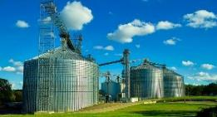


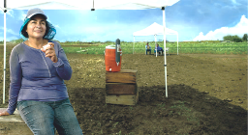
IV. OSHA Initiatives
Notes:
OSHA INITIATIVES
Through special focus campaigns, OSHA combines traditional, web, and social media outreach to increase awareness of workplace hazards.

Slide 83
Safety and Health Programs
Every effective safety and
health program includes
three key components:
  Management leadership
  Worker participation
  A systematic approach
  to finding and fixing
  workplace hazards
www.osha.gov/safeandsound/safety-and-health-programs
Notes:
SAFETY AND HEALTH PROGRAMS
OSHA has a basic requirement to implement safety and health programs for the construction industry.
Employers should consider best practices to establish safety and health programs that include management leadership, worker, and union participation, as well as a systematic and proactive approach to finding and fixing hazards that go above and beyond the minimum statutory requirements.

Slide 84
BENEFITS TO THE BOTTOM LINE
Safety and health programs
help businesses:
Prevent workplace injuries and illnesses
Improve compliance with laws and regulations
Reduce costs, including workers' compensation premiums
Engage workers
Enhance social responsibility goals
Increase productivity and enhance overall business operations
Benefits
Notes:
BENEFITS TO THE BOTTOM LINE
These programs are proven to protect workers and strengthen businesses in the following ways:
Prevent workplace injuries and illnesses
Improve compliance with laws and regulations
Reduce costs, including workers' compensation premiums
Engage workers
Enhance social responsibility goals
Increase productivity and enhance overall business operations

Slide 85

Safe + Sound Campaign
Every workplace should have a safety and health program
that includes key elements to protect workers.
Good for workers and businesses’ bottom line
Targets small and medium-sized businesses
www.osha.gov/safeandsoundweek
Notes:
SAFE + SOUND CAMPAIGN
The Safe + Sound campaign reinforces the importance of safety and health programs. Each year, Safe + Sound week encourages employers and workers to host activities and events across the country to promote proactive safety and health programs.
For those of you who have participated in previous years —thank you--and I hope you will join us in this year’s event. Safe & Sound Week 2019 is scheduled for Aug 12-18.
Most importantly, please make sure you have an effective program in place. You can find an excellent example of recommended practices for implementing on OSHA’s website.

Slide 86


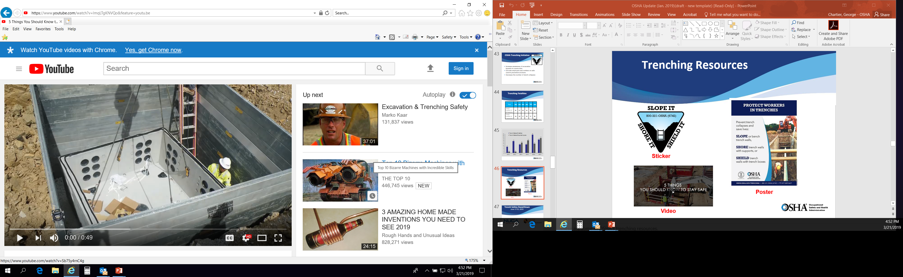
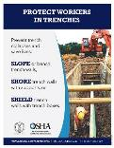

Preventing Trenching Incidents
Excavations
in Construction
DOL’s Strategic Plan identifies trenching hazards as an agency priority.
OSHA’s goal is to increase the
number of corrected trenching
hazards through enforcement
and consultation.
English
Spanish
5 Things You
Should Know
To Stay Safe
in a Trench
sticker
poster
www.osha.gov/trenching
Notes:
PREVENTING TRENCHING INCIDENTS
In response to a recent spike in trenching fatalities, OSHA is increasing its outreach and enforcement efforts related to trenching and excavation.
The Department’s strategic plan identifies trenching as an agency priority goal to increase the number of corrected trenching hazards through enforcement and consultation.
OSHA is promoting stronger industry awareness about the seriousness of trenching hazards and the means available to address them. OSHA has updated the trenching QuickCard, printed new trenching posters for your worksites and offices, and designed a hard hat sticker to mirror OSHA’s regulation: Slope it, Shore it, Shield it. Secretary Acosta recorded a public service announcement and there are trenching videos available for training and education purposes.
In June 2018, OSHA, the National Utility Contractors Association (NUCA), and the North American Excavation Shoring Association (NAXSA) hosted a Trenching Safety Stand-Down. Stand-Downs were held at over 750 jobsites, reaching more than 20,000 workers, both in the U.S. and abroad.
Building on that widespread participation, the agency is holding another Trenching Stand-Down in June 2019. OSHA encourages everyone here whose operations involve trenches to participate.

Slide 87

Suicide Prevention
sticker
www.osha.gov/preventingsuicides
Notes:
SUICIDE PREVENTION
Suicide is a serious public health problem that can have lasting harmful effects on individuals, families, workplaces, and communities.
While everyone experiences stress at times, sometimes it can be overwhelming and lead to suicidal thoughts or actions.
OSHA is looking into all available government resources to help raise awareness of the issue of suicide.
This is a complicated issue, because of the overlapping work and non-work factors involved, including a connection to the issue of opioid use and overdose.
The agency is looking at ways to productively work with other agencies and stakeholders to help shed light on this problem, and find ways to help prevent these terrible incidents from happening.
OSHA has created a new webpage with free and confidential resources to help employers and workers identify the warning signs, and know who and how to call for help.

Slide 88

Suicide Prevention Webpage www.osha.gov/preventingsuicides
New

Slide 89

Work Zone Awareness Week
Annual spring campaign held at the start of construction season to encourage safe driving through highway work zones
OSHA’s Roadway Work Zone Alliance supports the week and developed this poster
www.osha.gov/doc/highway_workzones
Notes:
WORK ZONE AWARENESS WEEK
OSHA’s Roadway Work Zone Alliance conducts an annual spring campaign, held at the start of construction season, to encourage safe driving through highway work zones.
The week-long effort encourages employers at construction sites to pause work voluntarily one day during the week to review best safety practices and to discuss struck-by hazards. Each year, more than 1,000 workers participate in these events.
This year the campaign runs April 8-12-2019.

Slide 90

Grain Safety
Six steps to grain safety:
Never walk down grain
Guard elevated work surfaces
Watch for moving equipment
Control the dust
Safeguard moving equipment
Lockout equipment before maintenance
www.standupevents.org/grain/
Notes:
GRAIN SAFETY
Many workers every year are injured or lose their lives in preventable grain engulfments. According to the latest data available from Purdue University, there were 23 documented grain engulfment incidents in 2017, including 11 that resulted in fatalities.
Six steps can help keep workers safe:
Never walk down grain
Guard elevated work surfaces
Watch for moving equipment
Control the dust
Safeguard moving equipment
Lockout equipment before maintenance
Since 2016, OSHA has partnered with industry to sponsor the Stand-Up to Prevent Grain Engulfment.
This year’s events were held the week of March 25-29.
The agency thanks everyone who has participated, and encourages others who face this hazard in their workplaces to participate next year.

Slide 91


Stop Falls: Fall Prevention Campaign
Falls are the leading cause of worker fatalities
in construction. These are preventable.
  PLAN ahead to get the job done safely.
  PROVIDE the right equipment.
  TRAIN everyone to use equipment safely.
5 ways to Prevent Workplace Falls
osha.gov/stopfalls
Notes:
STOP FALLS: FALL PREVENTION CAMPAIGN
One of OSHA’s major initiatives is the fall prevention campaign. Falls continue to be the leading cause of worker fatalities in the construction industry. Fall protection and education also continues to be in OSHA’s top ten cited regulations.
To help raise awareness and encourage the prevention of falls, each year the agency, in coordination with NIOSH, CPWR, and the National Occupational Research Agenda council hosts a National Fall Safety Stand-Down. Over the past 6 years, these events have reached nearly 10 million workers.
This year’s event took place May 6-10, 2019, to coincide with National Construction Safety Executives Safety Week. OSHA thanks all the participating employers and workers whose workplaces have fall hazards.

Slide 92
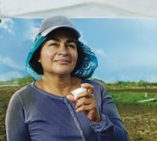


Heat Illness Prevention Campaign
Heat illness sickens thousands and results in the deaths of dozens of workers each year
Campaign educates employers and workers on danger of working in heat, and three steps to prevention: WATER. REST. SHADE.
Resources include OSHA-NIOSH heat safety app
Informal launch is “No-Fry Day” – Friday before Memorial Day
OSHA Heat Illness Prevention Campaign
Spanish
English
osha.gov/heat
Notes:
HEAT ILLNESS PREVENTION CAMPAIGN
Every year, dozens of workers die and thousands more become ill while working in extreme heat. More than 40 percent of heat-related worker deaths occur in the construction industry, but workers in every field are susceptible.
Each year, OSHA launches its annual Heat Illness Prevention campaign on the Friday before Memorial Day – also known as “Don’t Fry Day.”
Since 2011, OSHA has been educating employers and workers about the dangers of working in the heat. The agency has been getting the word out through training sessions, outreach events, information sessions, publications, social media messaging, and media appearances. Millions of workers and employers have learned how to stay safe in hot conditions. Whether you are exposed to the sun or another source of heat, our message is simple and direct: Water. Rest. Shade.
In 2017, OSHA collaborated with the National Institute for Occupational Safety and Health (NIOSH) to update the popular heat safety smartphone app. The app has been downloaded by more than 450,000 users since 2011 (who here has it?). The app features real-time heat index and hourly forecasts, specific to the user’s location, as well as occupational safety and health recommendations from OSHA and NIOSH. The OSHA-NIOSH Heat Safety App is a useful resource for planning outdoor work activities.

Slide 93



Protecting Young Workers
Workers of all ages have rights to safe workplaces:
to raise concerns about hazards without fear of retaliation
to receive training and PPE
to ask questions if something seems unsafe
www.osha.gov/youngworkers
#MySafeSummerJob
OSHA: Young Workers’ Rights (Spanish)
OSHA: Young Workers’ Rights (English)
Notes:
PROTECTING YOUNG WORKERS
Every minute a young worker (age 15-25) is injured on the job and every day one young worker loses their life in a preventable workplace incident.
OSHA has resources including a webpage and a video (available in English and Spanish), to help deliver the message that workers of all ages have the right to a safe workplace.
Those rights include the right to ask questions if something seems unsafe, the right to report unsafe conditions without the fear of retaliation, and the right to receive training and protective gear.
OSHA has partnered with worker safety organizations on #MySafeSummerJob, a social media campaign to educate young workers about their rights in the workplace, how to speak up about dangerous work conditions, and how to protect themselves on the job.
Stakeholders joined OSHA, the U.S. Department of Labor's Wage and Hour Division, and others over five weeks in 2019 – April 15 through May 17 – to promote safety among young workers.
The campaign aimed to bring awareness to youth, educators, parents, supervisors, and employers about the importance of workplace safety.
Working together, we can increase hazard awareness and avoidance skills, and empower youth with knowledge of their workplace rights and responsibilities. We can teach them how to speak up about dangerous work conditions and how to protect themselves on the job. Together, we can prevent injuries, avoid illnesses, and save lives.

Slide 94



Slide 95

Working Together, We Can Help
www.osha.gov
800-321-OSHA (6742)

